Slide 1



Our DataFest Journey Begins
© 2017 Expedia, Inc. All rights reserved.
Notes:
(Sound of airplane arriving) .. (some appropriate background music) Expedia is proud to be the data sponsor of this year’s American Statistical Association Datafest. Our journey beings (animation/sound to make interesting?)

Slide 2






Expedia Inc. is the World’s largest Online Travel Agency
600M+ monthly visitors across 75+ countries
$70B+
Gross
Bookings
350k+ Hotels
1.2M+ Vacation Rentals
500+ Airlines
150+ Car companies
20k+
Employees
Values are for 2016, as of 12/31/16
Notes:
Expedia Inc is the world’s largest online travel agency, using technology to revolutionize travel.
Expedia today has over 600 million monthly visitors in over 75 countries. We had over 70 billion dollars of gross bookings in 2016. We work with over 500 airlines and 150 car rental companies. And in accommodation – from which the dataset comes from - we offer over 350,000 hotels and 1.2 million vacation rentals. These numbers keep constantly growing.
This is powered by over 20,000 employees around the globe, and our largest offices are in Seattle, London and Gurgaon, India. The analytic team that generated the dataset is based in Geneva, Switzerland, where the organization that manages the relationships and business with hotels is based. There we use machine learning techniques to build hotel recommendation and ranking systems and hotel revenue management algorithms. The team has previously sponsored two Kaggle competitions.

Slide 3






Portfolio of Leading Travel Brands
Notes:
(Sound effects?)
Expedia consists of a number of leading travel brands. There are full travel agencies such as Expedia, Travelocity, Orbitz and wotif. Hotels.com is the hotel specialist site. Homeaway is a leader in vacation rentals.

Slide 4
We like to have Fun!
San Francisco
Dara Khosrowshahi
CEO
Mark Okerstrom
CFO
Montreal
Bellevue
Amsterdam
London
Gurgaon
Notes:
(Animation)
Expedia enjoys celebrating successes and fosters an inclusive workplace. A selection of photos from our offices follow from top left:
Pride parade in San Francisco
Dara, our CEO, and Mark, our CFO, at the HQ summer party
Day of Caring across the world

Slide 5
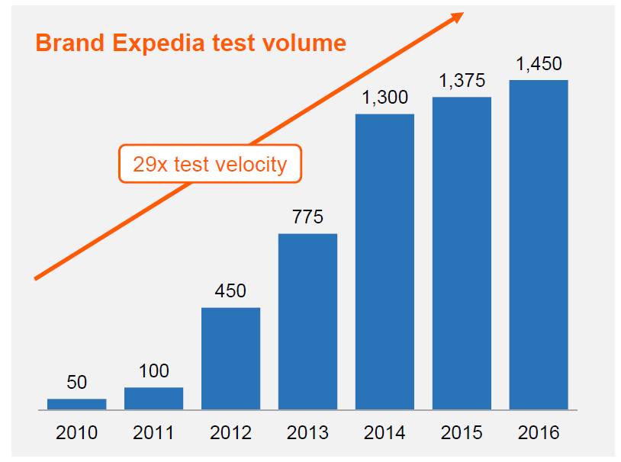
Analytics and Innovation are key for Us
~ 5500 of the best product & technology minds continuously test algorithms and ideas to improve the customer experience and journey on our sites
Technology Spend of over $1.2 Billion last year
Notes:
(Animation)
Analytics and Innovation are key for Expedia.
Over 5500 of the best product & technology minds continuously test algorithms and ideas to improve customer experiences. Data analysis is key to create tests that are likely to be winners. So we really care about data and extracting valuable insights from it. And given the breadth and depth of our business – we have a lot of data!

Slide 6
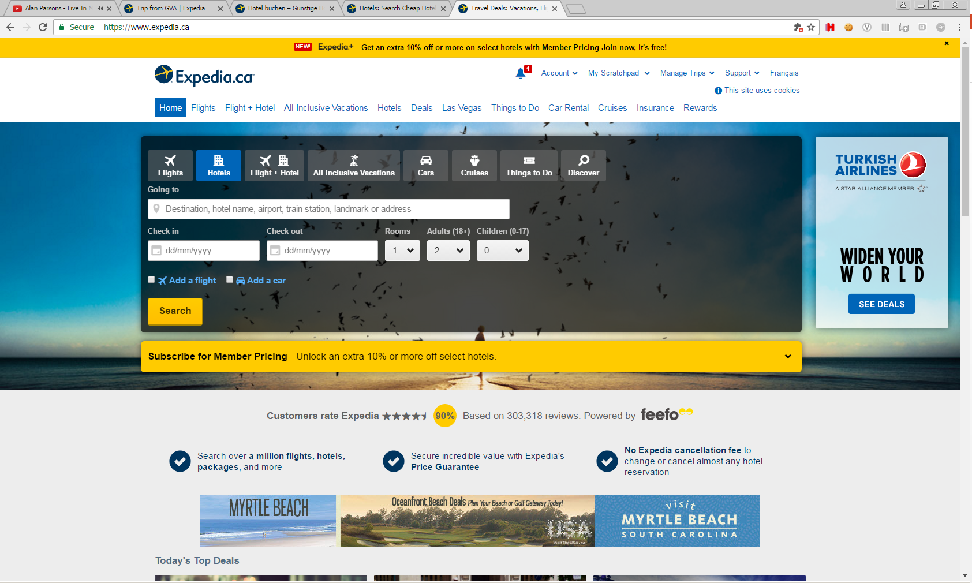
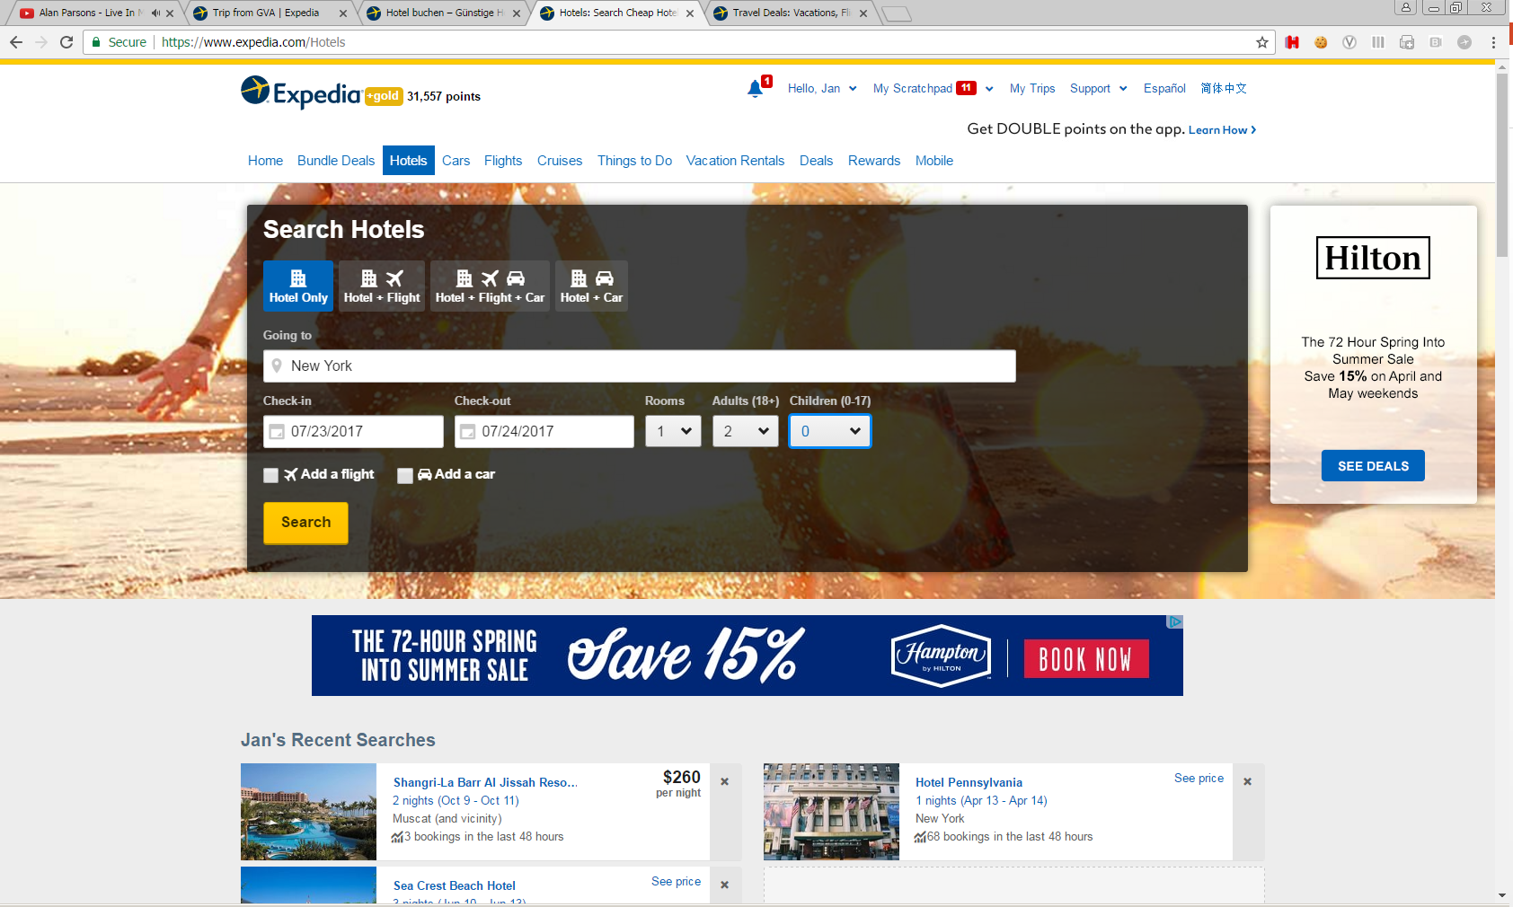
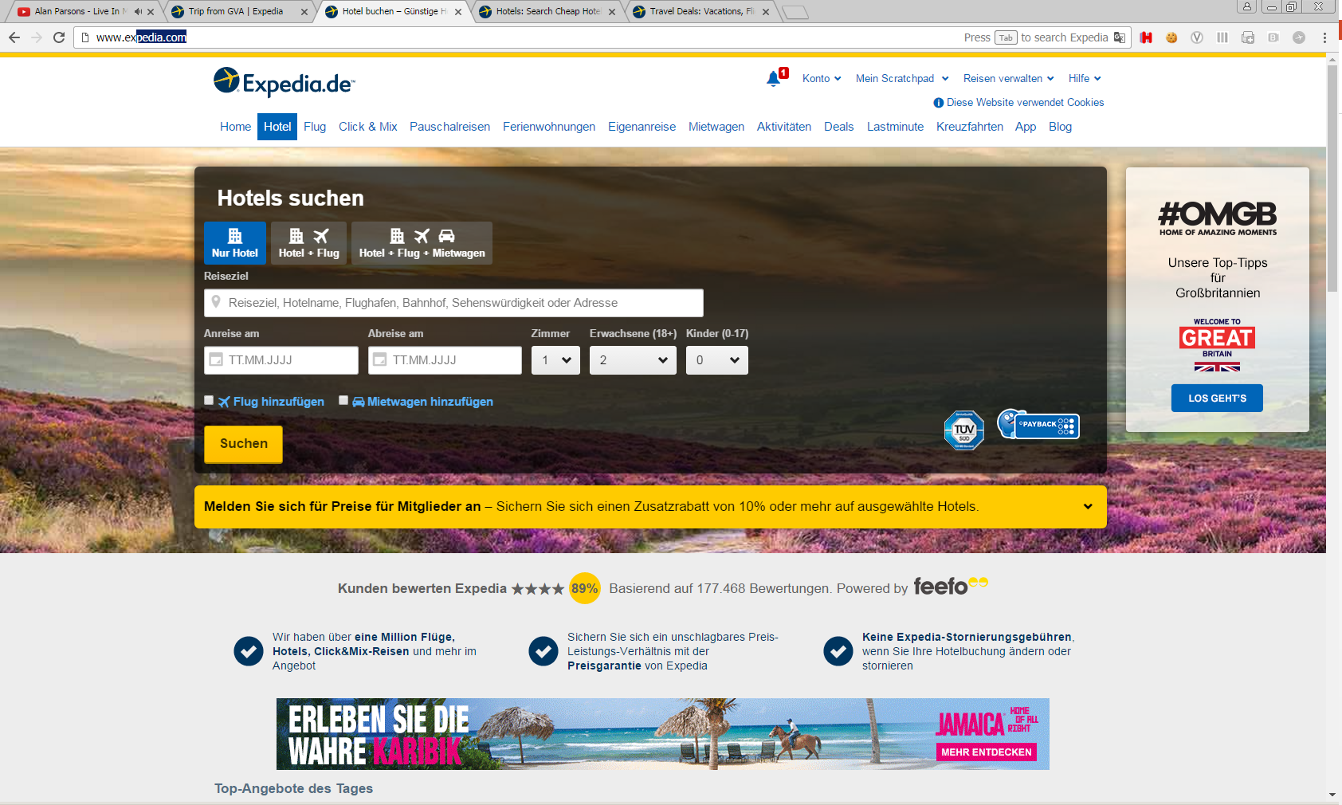
Hotel search data
date_time
site name
is_package
destination
srch_adults_cnt
srch_ci
srch_co
srch_rm_cnt
srch_children_cnt
Notes:
The following slides show how the data are generated on our sites.
(Ideally, the idea here would be to have a “filmed” version of the site as a user enters data and clicks onwards rather than having the next 3 slides with screen shots)
If you start at Expedia.com, you will have the option to search for a variety of products – here, we are concerned with hotels, which can also be searched for as part of a package. The destination and check-in and check-out dates are in plain site. There is a type-ahead feature for destination names, which can be larger areas (New York and vicinity), neighborhoods (Wall Street) or points of interest (Empire State building).
(Ideally, the “code names” of the fields come up with the voice over, i.e. is_package shown when refer to packages, srch_ci when check in mentioned, etc.)
For specifying children and to search for more than one room, you choose the “more options” in the number of adults.
Once a user has entered all the required information, they press on “Search” to continue and receive a list of recommended hotels.

Slide 7
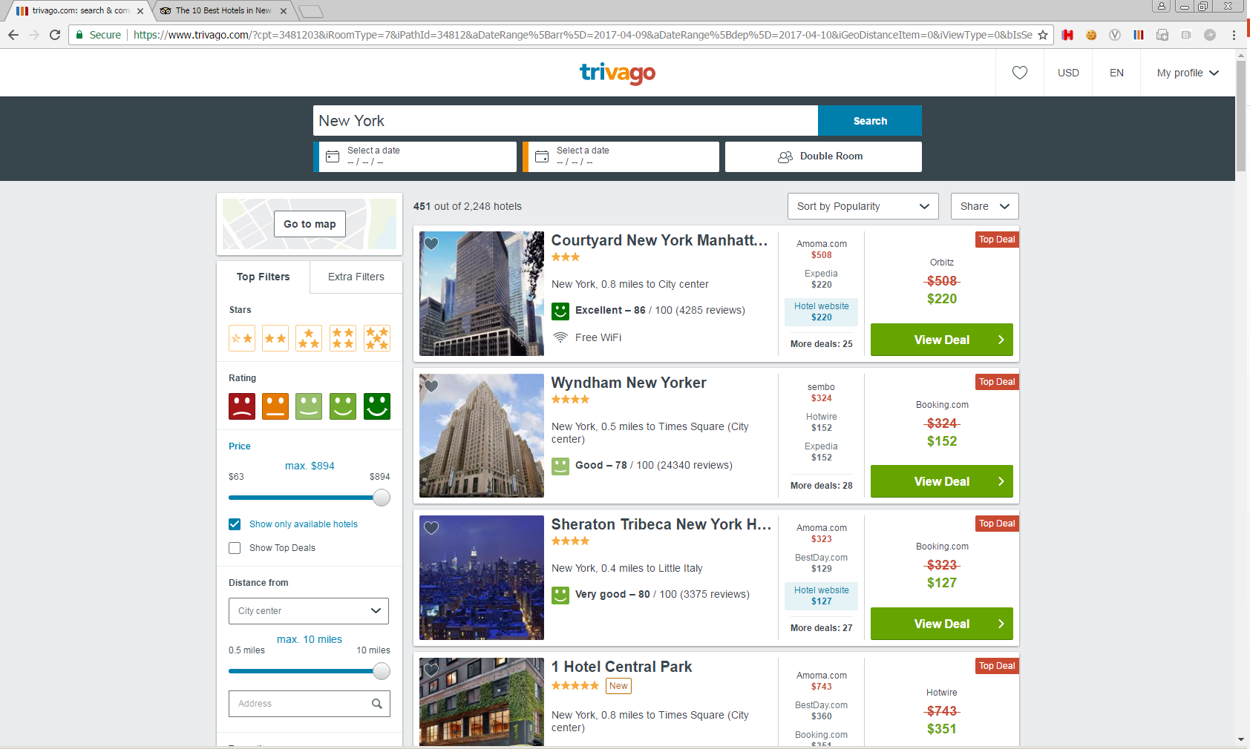
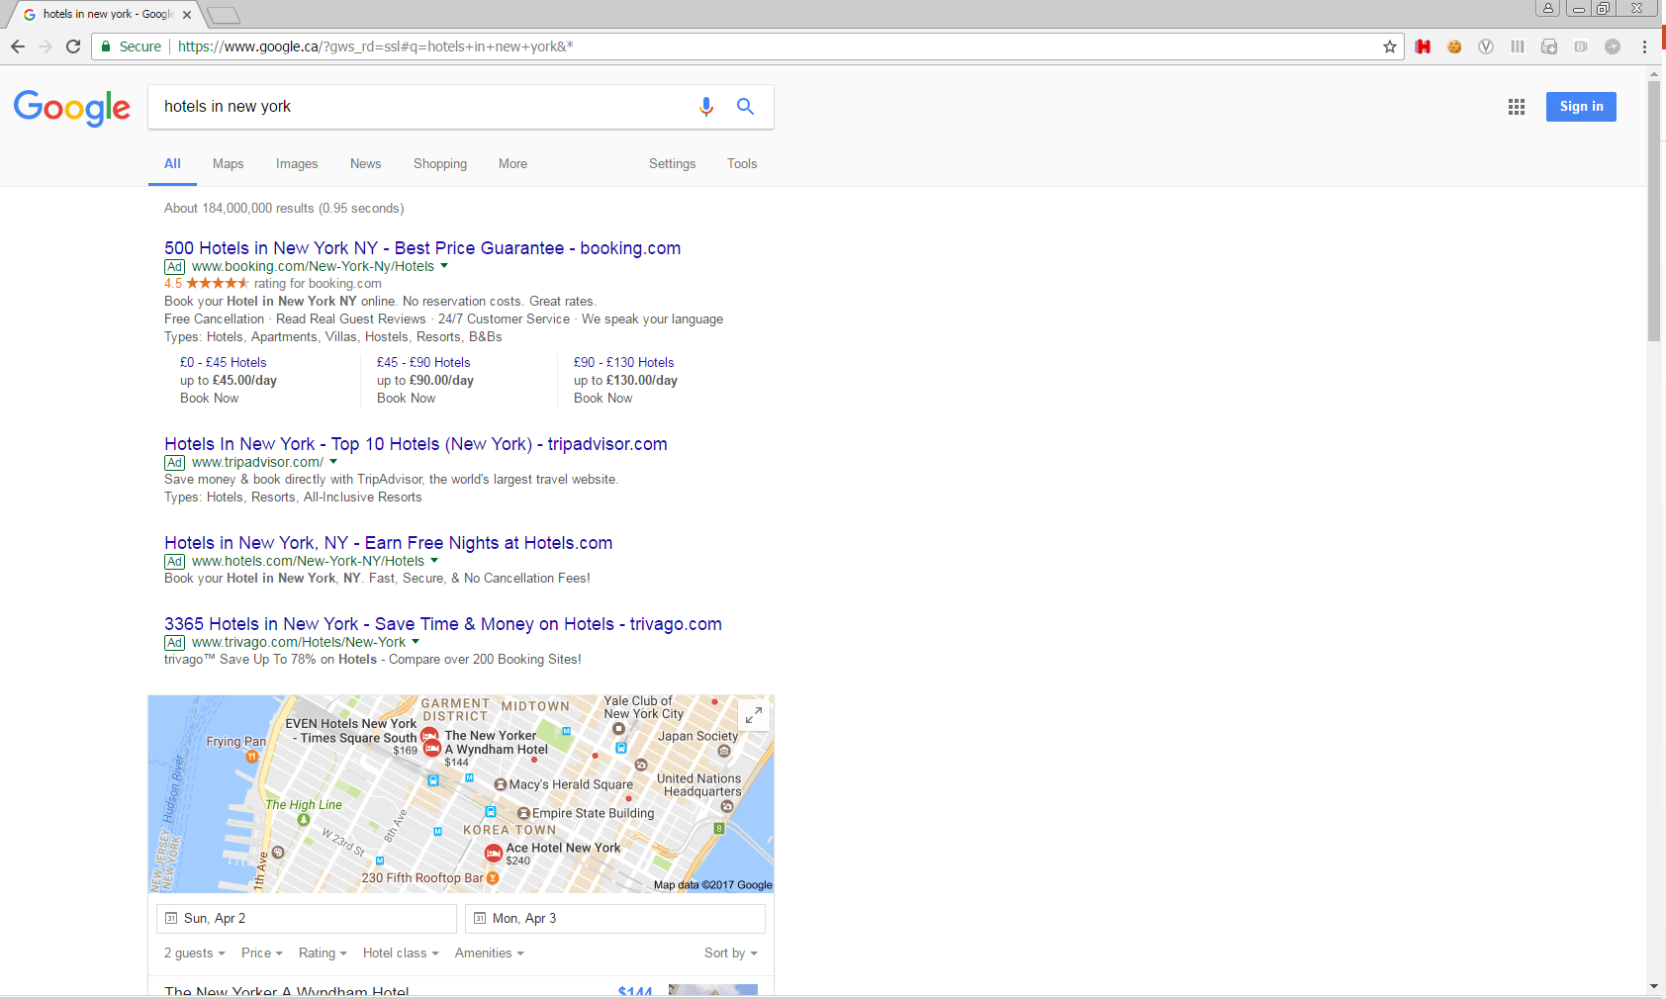
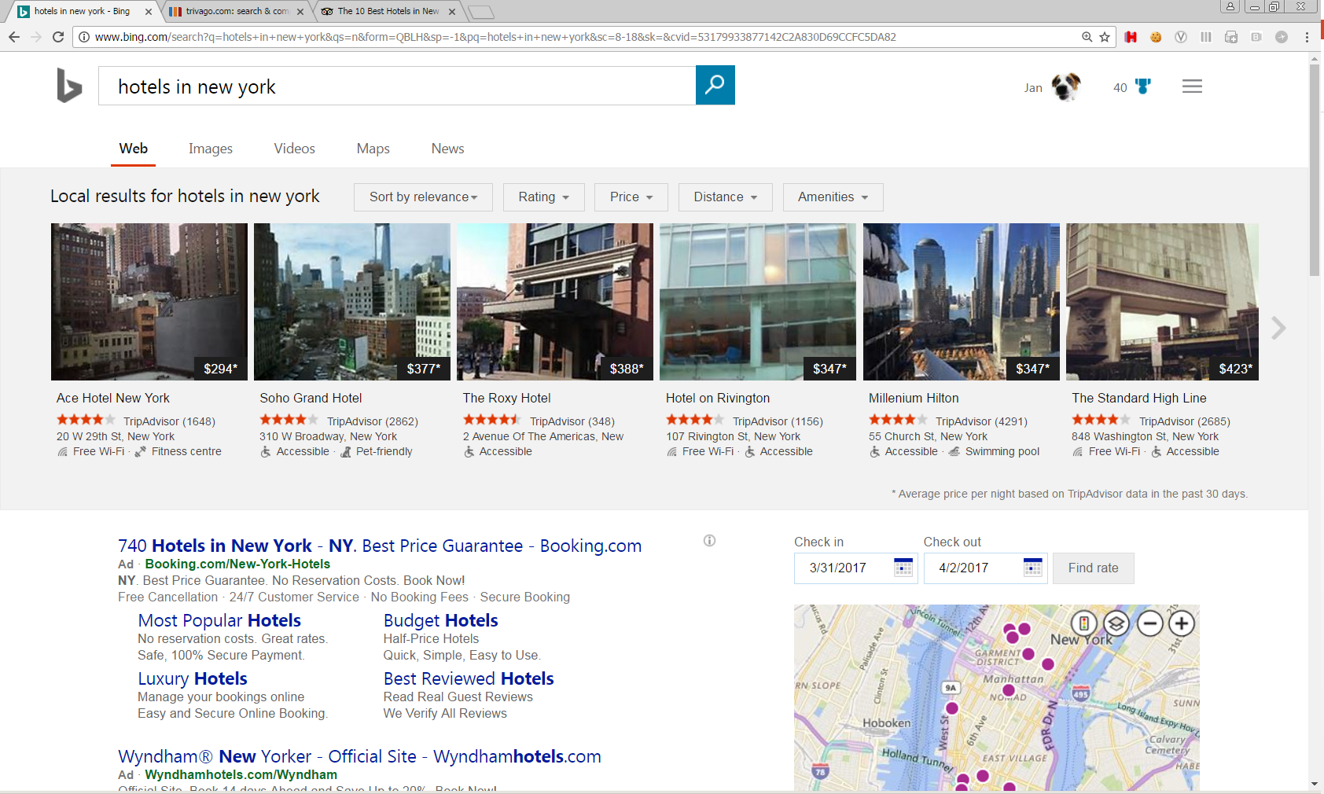
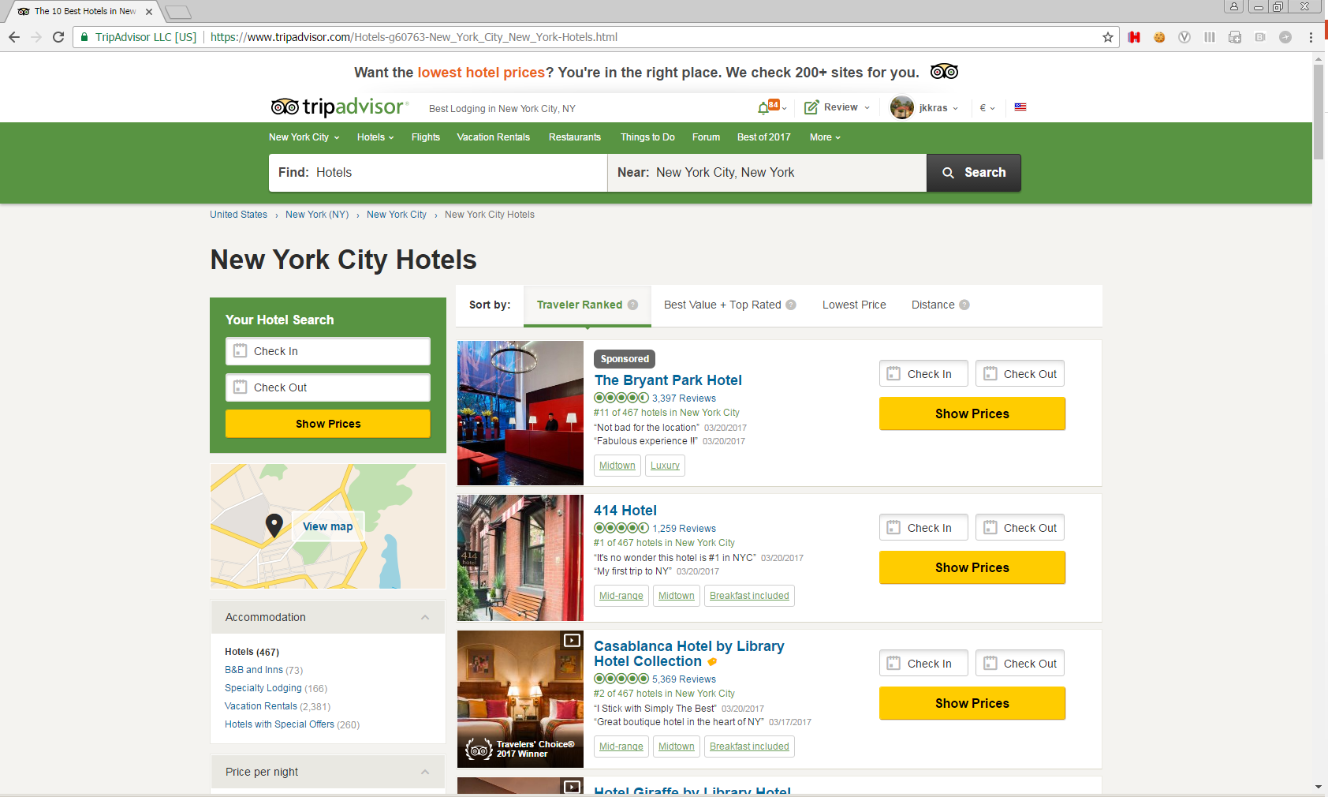
An Expedia search can be preceded by different channels
Notes:
Keep in mind that a search for a hotel on Expedia can be preceded by a search from a different channel. A user might first go to google, Trivago, Tripadvisor or another site and click on a link that takes them to Expedia.
(Again, if can have animation/film of users going to those sites and then being brought to Expedia, that would be great)

Slide 8
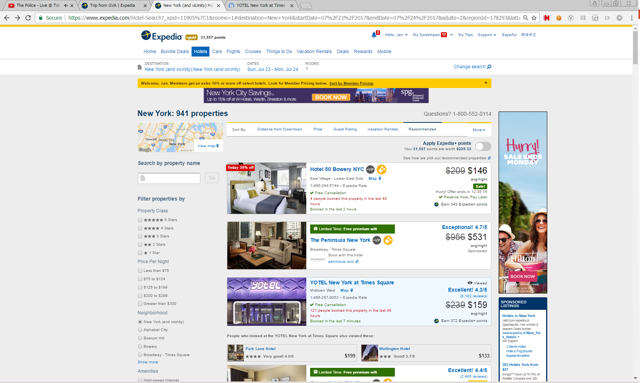
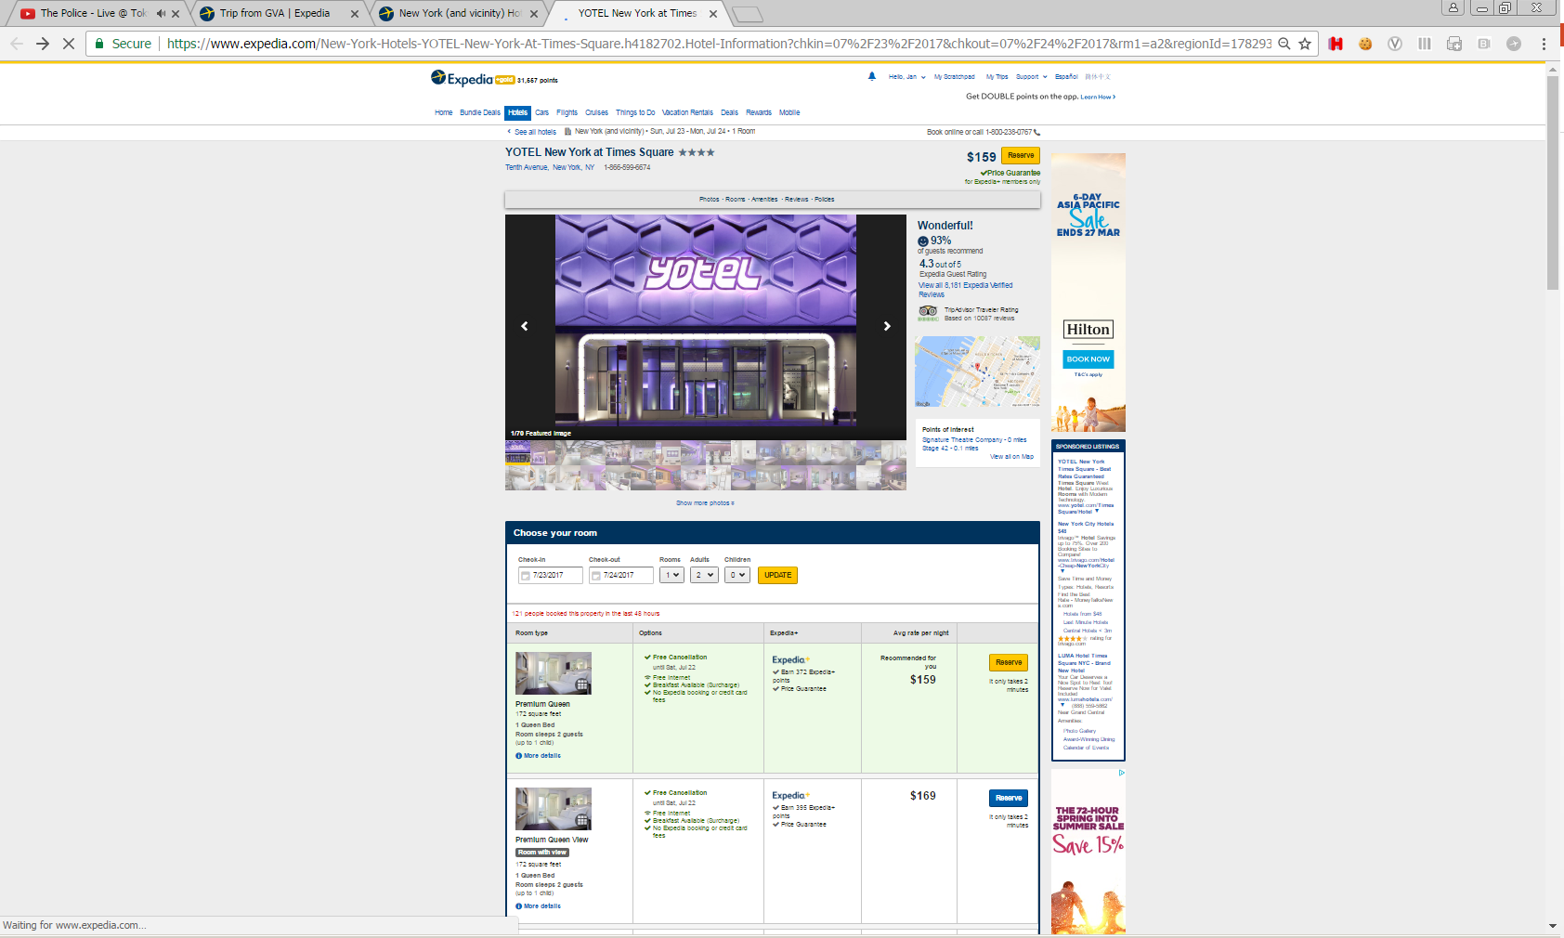
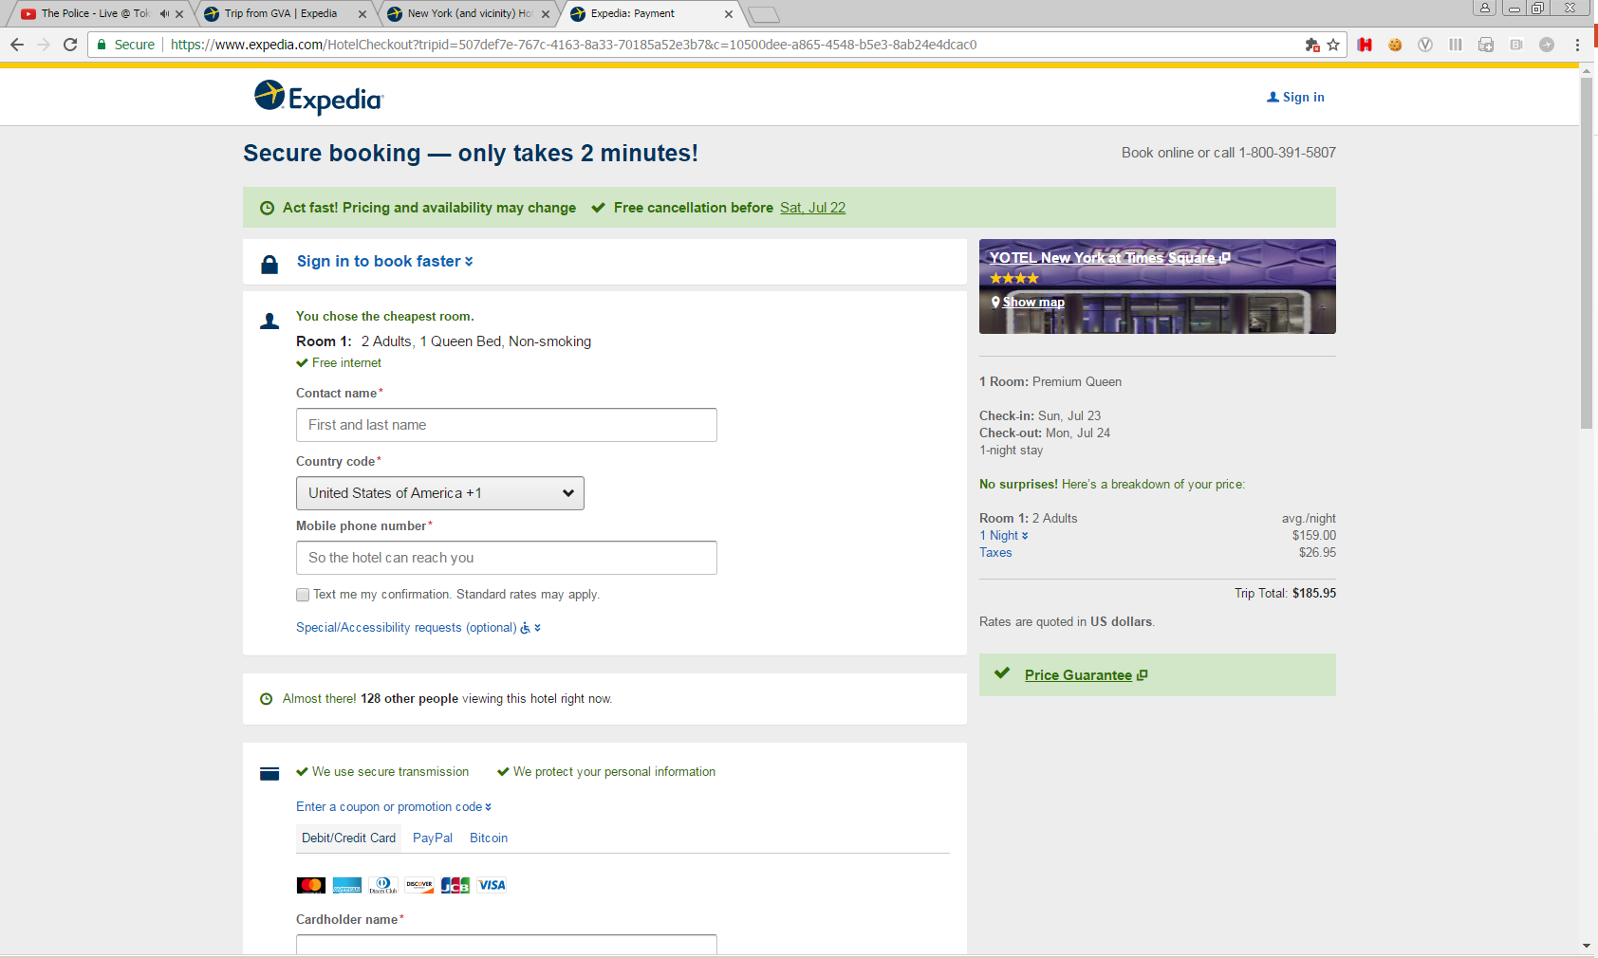
Search results are shown, hotels can be clicked and booked
Click
Book
Notes:
(Animation)
Once hotels are shown, users can click on the hotels to get more information about the hotel and potentially book it. This is registered as a row in the first file as a “click”. If during a session a user clicks on the same hotel a multiple number of times, then the count of these are recorded. If the user makes a booking of a hotel they clicked, another row is generated in the first file as a “booking”.

Slide 9
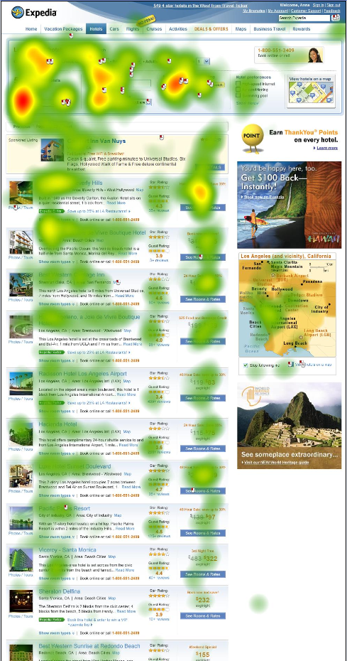
Real data are not perfect
Strong position bias, by design
Missing regions
Missing lat, longs
Region names that do not make sense
Searches with no occupancy
Notes:
(Animation)
Keep in mind .. Real data are not perfect, and we gave you real data.
There is strong position bias in the generation of the clicks and bookings. Customers tend to pay attention to what is at the top of the hotel listings, and not to look too far down the list. The eye heat map (pictured) shows how much time people spend looking at different points on the site. And we work hard to determine the best offers for a customer search and put them on top. So hotels higher in the sort in general will have more clicks and bookings that those lower down. Customers also do not go past page 1 very often.
Do not get too concerned if you see some empty fields (especially with the regions), data that are not easy to discern or rows of data that might not seem to make sense. Just use you judgment to say if it is noise, or there is some meaningful data underneath.
There is a google docs that you can write your questions and we will try to answer them promptly.

Slide 10
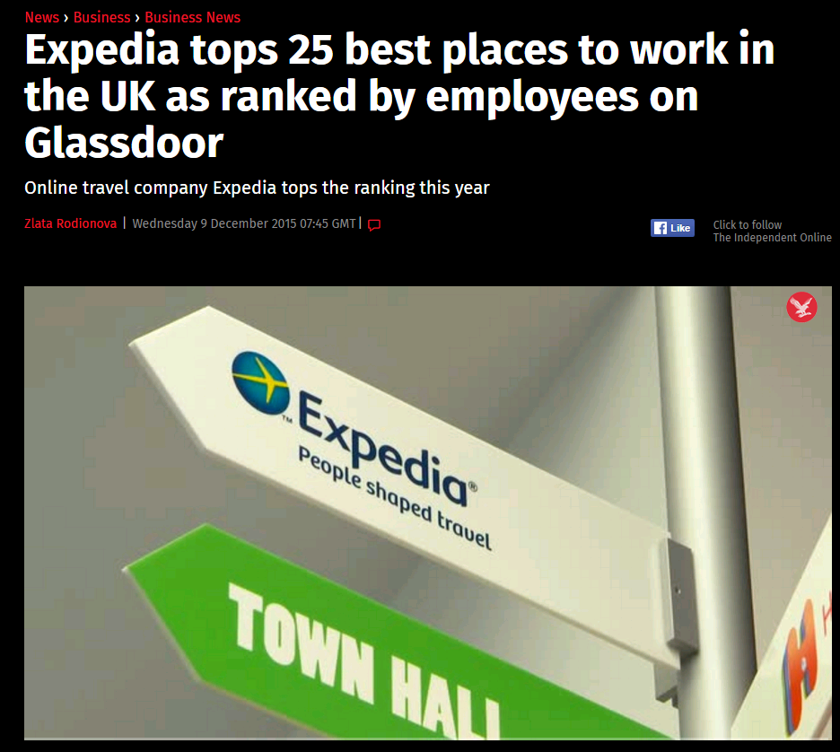
And We are Hiring
Email your CV and cover letter to: DataFest@expedia.com
Or visit: http://www.lifeatexpedia.com/
Contest Contacts if you want to email us directly:
Adam Woznica awoznica@expedia.com
Jan Krasnodebski jkrasnodebski@expedia.com
Notes:
(Animation)
And as a growing company, Expedia is hiring, especially people who like to work with data.
If you are interested in opportunities, feel free to send your CV to DataFest@Expedia.com, or visit us at www.lifeatexpedia.com.
And here are our email addresses if you want to contact us directly.

Slide 11

Have a great DataFest Voyage!
© 2017 Expedia, Inc. All rights reserved.
Notes:
(Animation, sound effects .. )
Have a great DataFest Voyage!

